Slide 1
Credit card applications Project
BY :-ARUN DEEPAK TIRKEY
ROLL NO :- 3468
CAMPUS :- DELHI

Slide 2
OBJECTIVE
1) This is an Credit card approval data and we are intended to frame a classification model that can give us a regressed prediction of the Approval Status such that we can predict which customer application will be approved for credit card or not.
2) Considering this objective, we are running a LOGISTIC REGRESSION MODEL on target/dependent variable Y, to analyse the influence of several independent factors that affect Y.

Slide 3
DEPENDENT VARIABLE
Dependent variable of this model is APPROVAL STATUS. As this describe after checking details of customer application whether he will be approved for credit card or not.
This is the dependent variable as all the variables contribute to form APPROVAL STATUS.

Slide 4
Count of variables and observations
690 Observations
16 Variables

Slide 5
SIGNIFICANT VARIABLES
Debt
Married
BankCustomer
EducationLevel
PriorDefault
CreditScore
Income

Slide 6
INSIGNIFICANT VARIABLES
Employed
Age
Ethnicity
Citizen
YearsEmployed
Gender
DriverLicense
Zipcode

Slide 7
Explanation of significant variables
Debt :- As debt feature decreases, it tends to increase the change of Credit Approval
Married :- As debt feature decreases, it tends to increase the change of Credit Approval
BankCustomer :- As debt feature increase, it tends to increase the change of Credit Approval
EducationLevel :- As debt feature increase, it tends to increase the change of Credit Approval
PriorDefault :- As debt feature increase, it tends to increase the change of Credit Approval
CreditScore :- As debt feature increase, it tends to increase the change of Credit Approval
Income :- As debt feature increase, it tends to increase the change of Credit Approval

Slide 8
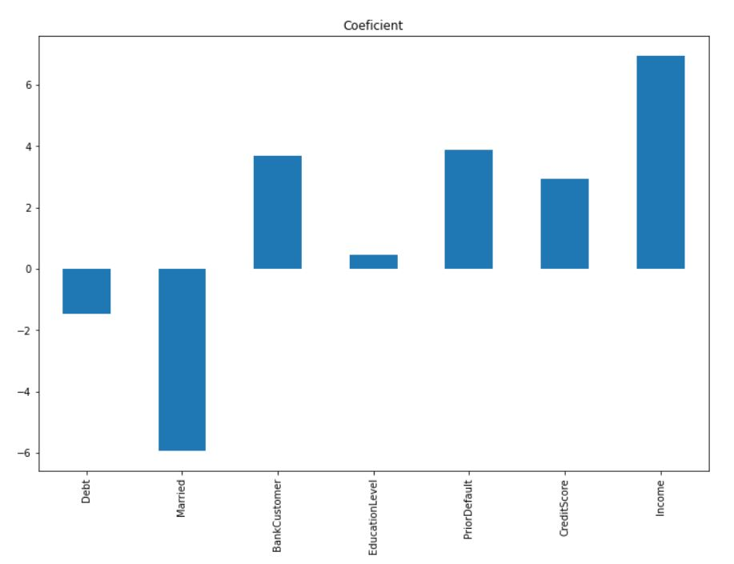
Graphical display of significant variables
Significant variable

Slide 9
RESULTS OBTAINED
Debt :- Debt coefficient is negative and value is second highest. As credit card approval tends to decide by this factor.
Married:- Married coefficient is negative and so higher in value . Customer having marriage tends to get less approval.
BankCustomer :- BankCustomer coefficient is positive and third highest in value. Customer having bank account in that bank have more changes to get credit.
EducationalLevel:- EducationalLevel coefficient is positive and less in value. It having less influence than other variable.
PriorDefault:- PriorDefault coefficient is positive and second highest in value. It is also decision factor as it tell whether the customer pay the bill in future.
CreditScore:- CreditScore coefficient is positive and high in value. This score tells the customer participation and earn score . This too affect approval
Income:- Income is positive and highest in value. Income is the most important decision factor for approval.

Slide 10

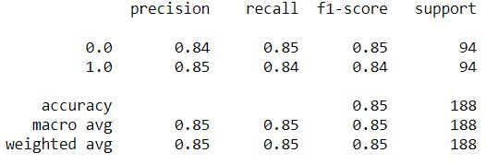
TESTS
Accuracy score of test data = 85%
Confusion matrix of test data =
Classification Report of test data =

Slide 11
Variable relationships:
Positive variables: Mention the variables with positive coefficients of your final model here.
BankCustomer, EducationLevel, PriorDefault, CreditScore, Income
Negative Variables: Mention the variables with negative coefficients of your final model here.
Debt, Married

Slide 12
BUSINESS RECOMMENDATIONS:
Debt variable is negative as debt of a customer tells possibility of no bill payment in future and its coefficient is -1.4587 .
Married variable contribute highest to the ApprovalStatus which is coefficient negative 5.9327. This implies married couple gets less approval.
BankCustomer variable contribute third highest to ApprovalStatus which is coefficient positive 3.6853. This implies that customer holding same bank account having more Approval changes.
EducationalLevel variable contribute least to ApprovalStatus which is coefficient positive 0.4488. This implies that customer having any education level doesn’t affect approval changes that much.
PriorDefault variable contribute second highest to ApprovalStatus which is coefficient positive 3.8833. This implies that PriorDefault have huge impact on ApprovalStatus as this tell the track record of customer and possibility of future default.

Slide 13
CreditScore variable contribute third highest to the ApprovalStatus which is coefficient positive 2.9429 . More scores improves better approval probability.
Income variable contribute highest to ApprovalStatus which is coefficient positive 6.9531. This is major factor to decide approval.

Slide 14
THANK YOU.

